Slide 1
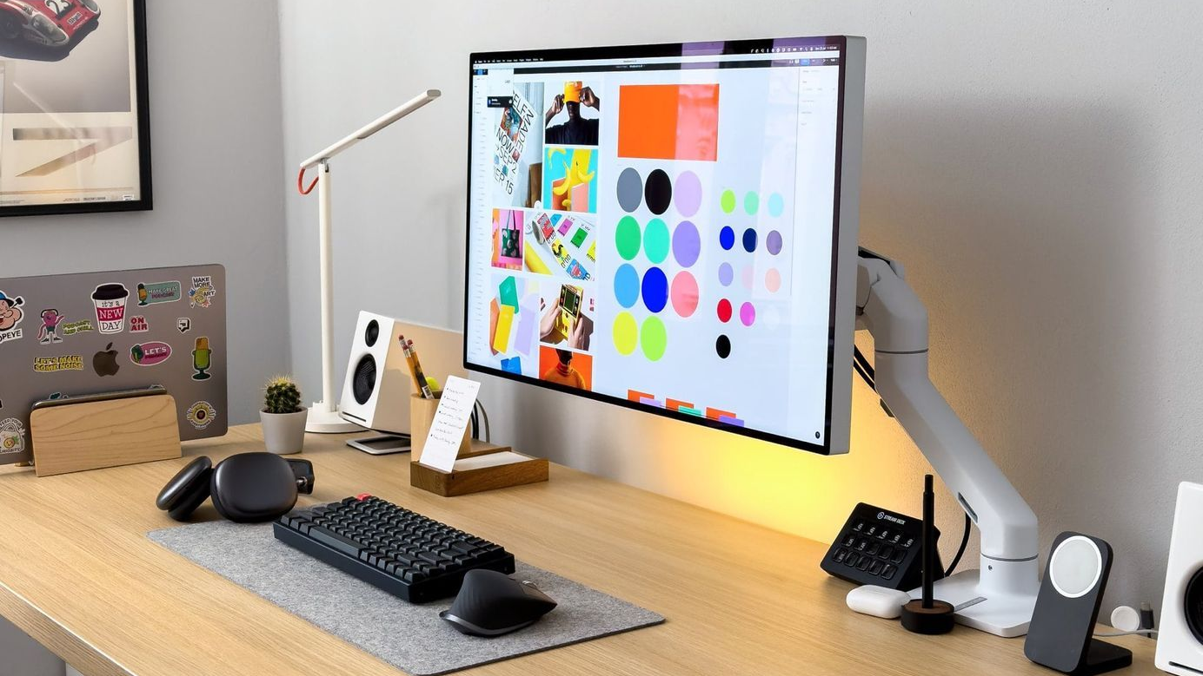
Create More.
Stress Less.
Automations for creators that handle content ops, DMs, leads, and reporting—on a creator-friendly budget.
Book Free Audit
See Creator Systems

Slide 2
The Hidden Chaos Behind
Every Creator's Feed
Your audience sees content. We automate everything behind it.
Content planning takes hours
Editing + repurposing is never-ending
Brainstorming, researching trends, and mapping out posts becomes a full-time job that drains creative energy.
One video becomes 10 clips, captions, thumbnails. The editing treadmill never stops turning.
DMs + brand inquiries get missed
Analytics are scattered
Sponsorship opportunities slip through the cracks while you're busy creating. Thousands in lost revenue.
Different platforms, different metrics. No clear picture of what's actually working or what to post next.

Slide 3
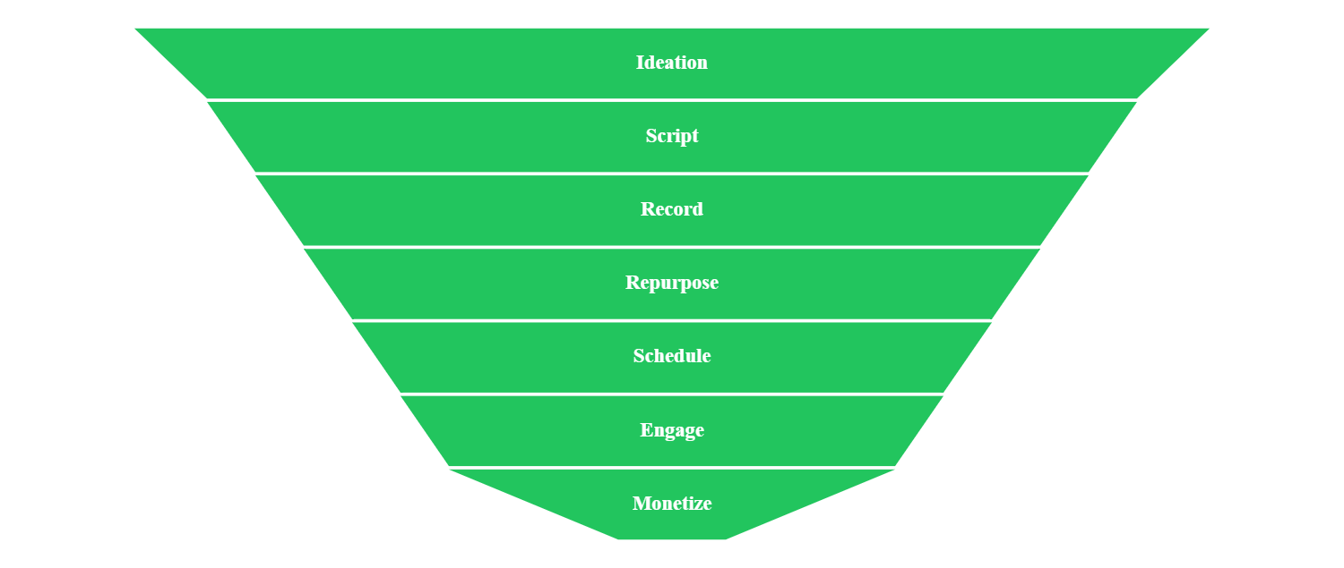
The Creator Automation Funnel
Everything. Automated. Seamless.

Slide 4
6 Automations We Build for Creators
Plug-and-play systems. Zero complexity. Maximum leverage.
Content Machine
Repurpose Engine
DM Assistant
Ideas → drafts → weekly content plan. Automated trend pulling, hook generation, and editorial calendar management.
YouTube → Reels/Shorts/TikTok. Auto-generated captions, titles, and thumbnail concepts. One video becomes 10 assets.
Filter, label, auto-reply, escalate. FAQ bots handle common questions. Brand inquiries get flagged instantly.
3-5x faster content creation
10x content multiplier
Zero missed opportunities
Brand Deal Pipeline
Community Ops
Analytics Snapshot
Form → rate card → proposal → follow-ups. Complete CRM tracking from inbound inquiry to signed contract.
Welcome messages, resource libraries, event reminders. Keep your community engaged without the manual work.
Weekly performance reports + what to post next. Data-driven recommendations delivered to your inbox.
2x higher close rates
5x engagement boost
Clear growth roadmap

Slide 5
Choose Your Growth Engine
Cheap price. High leverage. Built for solo creators.
Most Popular
Starter
Growth
Pro
$199
$499
$999
/mo
/mo
/mo
Perfect for getting started with one core system
The sweet spot for serious creators
Complete automation suite for scaling
Content Machine + Repurpose Engine
Everything in Growth
Choose 20 systems:
Content Machine OR DM Assistant
Brand Deal Pipeline CRM
DM Assistant + Scheduling
Community Ops automation
Basic setup & onboarding
Priority support + monthly optimization
White-glove setup + optimization
Email support
Analytics Snapshot
Get Started
Start Growing
Go Pro
✓ Built for solo creators. No complex setup. Cancel anytime.

Slide 6
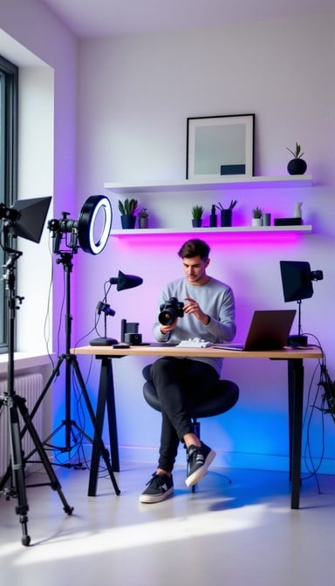
Get Your Creator System in 7 Days
Join hundreds of creators who've automated the busywork and scaled their impact
More content output without burnout
Never miss a brand inquiry again
Clear weekly performance insights
Consistent posting schedule without the 12-hour days
Every opportunity captured, tracked, and followed up automatically
Know exactly what's working and what to create next
Request Callback
Creator Results
"Faster turnaround"
"Consistent posting"
"Fewer missed deals"
Tech YouTuber, 500K subs
Lifestyle creator, 1.2M followers
Beauty influencer, 250K subs

